Slide 1
CSE 323 Computer Architecture
Lecture 5: Internal Memory
Anisur Rahman
Military Institute of Science and Technology
Notes:
We begin this chapter with a survey of semiconductor main memory subsystems, including ROM, DRAM, and SRAM memories. Then we look at error control techniques used to enhance memory reliability. Following this, we look at more advanced DRAM architectures.

Slide 2
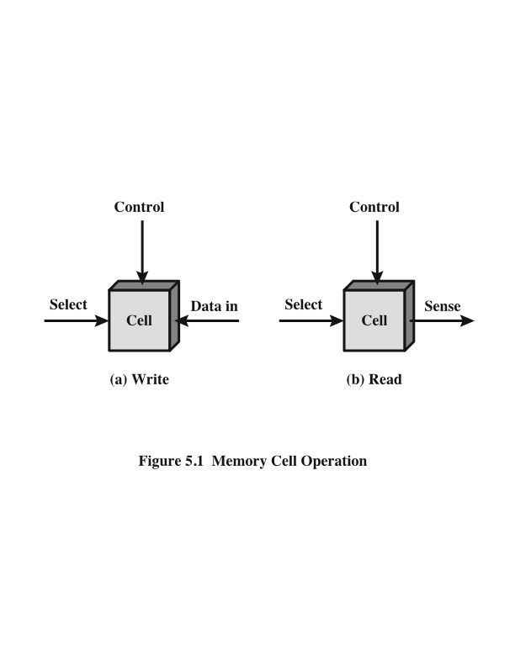
Memory Cell Operation
Notes:
In earlier computers, the most common form of random-access storage for computer main memory employed an array of doughnut-shaped ferromagnetic loops referred to as cores. Hence, main memory was often referred to as core, a term that persists to this day. The advent of, and advantages of, microelectronics has long since vanquished the magnetic core memory. Today, the use of semiconductor chips for main memory is almost universal. Key aspects of this technology are explored in this section.
The basic element of a semiconductor memory is the memory cell. Although a variety of electronic technologies are used, all semiconductor memory cells share certain properties:
• They exhibit two stable (or semistable) states, which can be used to represent binary 1 and 0.
• They are capable of being written into (at least once), to set the state.
• They are capable of being read to sense the state.
Figure 5.1 depicts the operation of a memory cell. (Most commonly, the cell has three functional terminals capable of carrying an electrical signal. The select terminal, as the name suggests, selects a memory cell for a read or write operation. The control terminal indicates read or write. For writing, the other terminal provides an electrical signal that sets the state of the cell to 1 or 0. For reading, that terminal is used for output of the cell’s state. )The details of the internal organization, functioning, and timing of the memory cell depend on the specific integrated circuit technology used and are beyond the scope of this book, except for a brief summary. For our purposes, we will take it as given that individual cells can be selected for reading and writing operations.

Slide 3
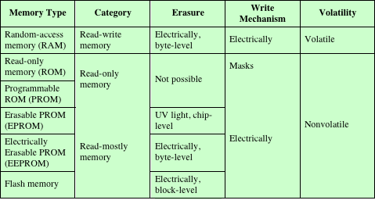
Semiconductor Memory Types
Table 5.1 Semiconductor Memory Types
Notes:
All of the memory types that we will explore in this chapter are random access. That is, individual words of memory are directly accessed through wired-in addressing logic.
Table 5.1 lists the major types of semiconductor memory. The most common is referred to as random-access memory (RAM). This is, in fact, a misuse of the term, because all of the types listed in the table are random access. One distinguishing characteristic of memory that is designated as RAM is that it is possible both to read data from the memory and to write new data into the memory easily and rapidly. Both the reading and writing are accomplished through the use of electrical signals.
The other distinguishing characteristic of RAM is that it is volatile. A RAM must be provided with a constant power supply. If the power is interrupted, then the data are lost. Thus, RAM can be used only as temporary storage. The two traditional forms of RAM used in computers are DRAM and SRAM.

Slide 4
Dynamic RAM (DRAM)
RAM technology is divided into two technologies:
Dynamic RAM (DRAM)->analog
Static RAM (SRAM)
DRAM
Made with cells that store data as charge on capacitors
Presence or absence of charge in a capacitor is interpreted as a binary 1 or 0
Requires periodic charge refreshing to maintain data storage
The term dynamic refers to tendency of the stored charge to leak away, even with power continuously applied
Notes:
RAM technology is divided into two technologies: dynamic and static. A dynamic RAM (DRAM) is made with cells that store data as charge on
capacitors. The presence or absence of charge in a capacitor is interpreted as a binary 1 or 0. Because capacitors have a natural tendency to discharge, dynamic RAMs require periodic charge refreshing to maintain data storage. The term dynamic refers to this tendency of the stored charge to leak away, even with power continuously applied.

Slide 5
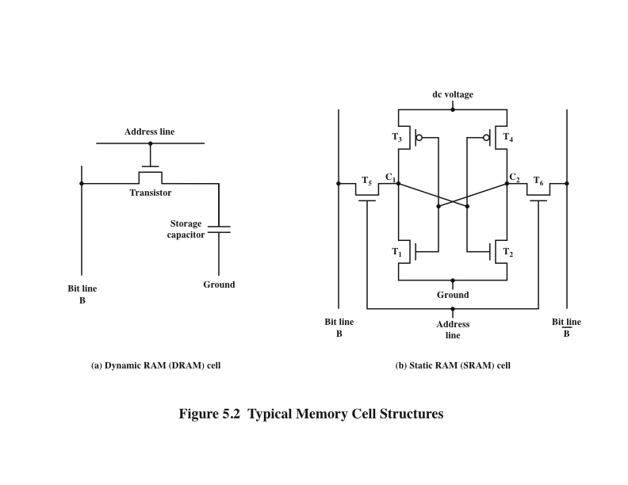
Dynamic RAM Structure
Figure 5.2a
Typical Memory Cell Structures
Notes:
Figure 5.2a is a typical DRAM structure for an individual cell that stores 1 bit. The address line is activated when the bit value from this cell is to be read or written. The transistor acts as a switch that is closed (allowing current to flow) if a voltage is applied to the address line and open (no current flows) if no voltage is present on the address line.
For the write operation, a voltage signal is applied to the bit line; a high voltage represents 1, and a low voltage represents 0. A signal is then applied to the address line, allowing a charge to be transferred to the capacitor.
For the read operation, when the address line is selected, the transistor turns on and the charge stored on the capacitor is fed out onto a bit line and to a sense amplifier. The sense amplifier compares the capacitor voltage to a reference value and determines if the cell contains a logic 1 or a logic 0. The readout from the cell discharges the capacitor, which must be restored to complete the operation.
Although the DRAM cell is used to store a single bit (0 or 1), it is essentially an analog device. The capacitor can store any charge value within a range; a threshold value determines whether the charge is interpreted as 1 or 0.

Slide 6
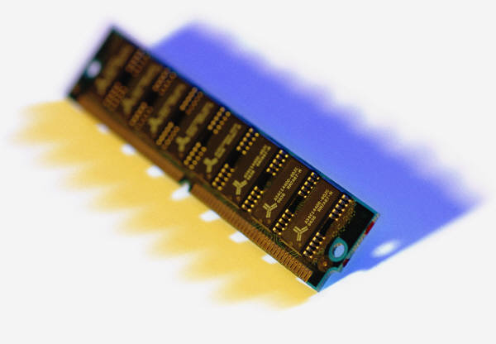
Static RAM (SRAM)
Digital device that uses the same logic elements used in the processor
Binary values are stored using traditional flip-flop logic gate configurations
Will hold its data as long as power is supplied to it
Notes:
In contrast, a static RAM (SRAM) is a digital device that uses the same logic elements used in the processor. In a SRAM, binary values are stored
using traditional flip-flop logic-gate configurations (see Chapter 11 for a description of flip-flops). A static RAM will hold its data as long as power is supplied to it.

Slide 7
Static RAM Structure
Figure 5.2b
Typical Memory Cell Structures
Notes:
Figure 5.2b is a typical SRAM structure for an individual cell. Four transistors (T₁, T₂, T₃, T₄) are cross connected in an arrangement that produces a stable logic state. In logic state 1, point C₁ is high and point C₂ is low; in this state, T₁ and T₄ are off and T₂ and T₃ are on. In logic state 0, point C₁ is low and point C₂ is high; in this state, T₁ and T₄ are on and T₂ and T₃ are off. Both states are stable as long as the direct current (dc) voltage is applied. Unlike the DRAM, no refresh is needed to retain data.
As in the DRAM, the SRAM address line is used to open or close a switch. The address line controls two transistors (T₅ and T₆). When a signal is applied to this line, the two transistors are switched on, allowing a read or write operation. For a write operation, the desired bit value is applied to line B, while its complement is applied to line B. This forces the four transistors (T₁, T₂, T₃, T₄) into the proper state. For a read operation, the bit value is read from line B.

Slide 8
SRAM versus DRAM
SRAM
Both volatile
Power must be continuously supplied to the memory to preserve the bit values
Dynamic cell
Simpler to build, smaller
More dense (smaller cells = more cells per unit area)
Less expensive
Requires the supporting refresh circuitry
Tend to be favored for large memory requirements
Used for main memory
Static
Faster
Used for cache memory (both on and off chip)
DRAM
Notes:
Both static and dynamic RAMs are volatile; that is, power must be continuously supplied to the memory to preserve the bit values. A dynamic memory cell is simpler and smaller than a static memory cell. Thus, a DRAM is more dense (smaller cells = more cells per unit area) and less expensive than a corresponding SRAM. On the other hand, a DRAM requires the supporting refresh circuitry. For larger memories, the fixed cost of the refresh circuitry is more than compensated for by the smaller variable cost of DRAM cells. Thus, DRAMs tend to be favored for large memory requirements. A final point is that SRAMs are somewhat faster than DRAMs. Because of these relative characteristics, SRAM is used for cache memory (both on and off chip), and DRAM is used for main memory.

Slide 9
Read Only Memory (ROM)->Below
Contains a permanent pattern of data that cannot be changed or added to
No power source is required to maintain the bit values in memory
Data or program is permanently in main memory and never needs to be loaded from a secondary storage device
Data is actually wired into the chip as part of the fabrication process
Disadvantages of this:
No room for error, if one bit is wrong the whole batch of ROMs must be thrown out
Data insertion step includes a relatively large fixed cost
Notes:
As the name suggests, a read-only memory (ROM) contains a permanent pattern of data that cannot be changed. A ROM is nonvolatile; that is, no power source is required to maintain the bit values in memory. While it is possible to read a ROM, it is not possible to write new data into it. An important application of ROMs is microprogramming, discussed in Part Four. Other potential applications include
• Library subroutines for frequently wanted functions
• System programs
• Function tables
For a modest-sized requirement, the advantage of ROM is that the data or program is permanently in main memory and need never be loaded from a secondary storage device.
A ROM is created like any other integrated circuit chip, with the data actually wired into the chip as part of the fabrication process. This presents two problems:
• The data insertion step includes a relatively large fixed cost, whether one or thousands of copies of a particular ROM are fabricated.
• There is no room for error. If one bit is wrong, the whole batch of ROMs must be thrown out.

Slide 10
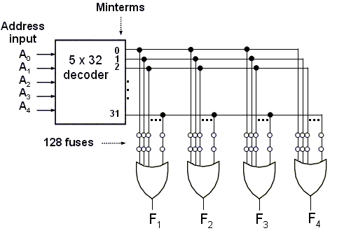
ROM Structure
Construction of a 32 x 5 ROM
Typical Memory Cell Structures
Notes:
construction of a 32 x 5 ROM. The five input variables are decoded in 32 lines by means of 32 AND gates and 5 inverters. Each output of the decoder represents one of the minterms of a function of five variables. The 32 outputs of the decoder are connected through fuses to each OR gate. Only four of these fuses are shown in the diagram, but actually each OR gate has 32 inputs and each input goes through a fuse that can be blown as desired.

Slide 11
Programmable ROM (PROM)->note same
Less expensive alternative
Nonvolatile and may be written into only once
Writing process is performed electrically and may be performed by supplier or customer at a time later than the original chip fabrication
Special equipment is required for the writing process
Provides flexibility and convenience
Attractive for high volume production runs
Notes:
When only a small number of ROMs with a particular memory content is needed, a less expensive alternative is the programmable ROM (PROM). Like the ROM, the PROM is nonvolatile and may be written into only once. For the PROM, the writing process is performed electrically and may be performed by a supplier or customer at a time later than the original chip fabrication. Special equipment is required for the writing or “programming” process. PROMs provide flexibility and convenience. The ROM remains attractive for high-volume production runs.

Slide 12
Read-Mostly Memory
EPROM
Erasable programmable read-only memory
Erasure process can be performed repeatedly
More expensive than PROM but it has the advantage of the multiple update capability
EEPROM
Electrically erasable programmable read-only memory
Can be written into at any time without erasing prior contents
Combines the advantage of non-volatility with the flexibility of being updatable in place
More expensive than EPROM
Flash Memory
Intermediate between EPROM and EEPROM in both cost and functionality
Uses an electrical erasing technology, does not provide byte-level erasure
Microchip is organized so that a section of memory cells are erased in a single action or “flash”
Notes:
Another variation on read-only memory is the read-mostly memory, which is useful for applications in which read operations are far more frequent than write operations but for which nonvolatile storage is required. There are three common forms of read-mostly memory: EPROM, EEPROM, and flash memory.
The optically erasable programmable read-only memory (EPROM) is read and written electrically, as with PROM. However, before a write operation, all the storage cells must be erased to the same initial state by exposure of the packaged chip to ultraviolet radiation. Erasure is performed by shining an intense ultraviolet light through a window that is designed into the memory chip. This erasure process can be performed repeatedly; each erasure can take as much as 20 minutes to perform. Thus, the EPROM can be altered multiple times and, like the ROM and PROM, holds its data virtually indefinitely. For comparable amounts of storage, the EPROM is more expensive than PROM, but it has the advantage of the multiple update capability.
A more attractive form of read-mostly memory is electrically erasable programmable read-only memory (EEPROM). This is a read-mostly memory that can be written into at any time without erasing prior contents; only the byte or bytes addressed are updated. The write operation takes considerably longer than the read operation, on the order of several hundred microseconds per byte. The EEPROM combines the advantage of non-volatility with the flexibility of being updatable in place, using ordinary bus control, address, and data lines. EEPROM is more expensive than EPROM and also is less dense, supporting fewer bits per chip.
Another form of semiconductor memory is flash memory (so named because of the speed with which it can be reprogrammed). First introduced in the mid-1980s, flash memory is intermediate between EPROM and EEPROM in both cost and functionality. Like EEPROM, flash memory uses an electrical erasing technology. An entire flash memory can be erased in one or a few seconds, which is much faster than EPROM. In addition, it is possible to erase just blocks of memory rather than an entire chip. Flash memory gets its name because the microchip is organized so that a section of memory cells are erased in a single action or “flash.” However, flash memory does not provide byte-level erasure. Like EPROM, flash memory uses only one transistor per bit, and so achieves the high density (compared with EEPROM) of EPROM.

Slide 13
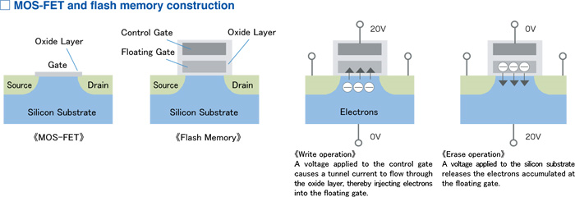
Flash memory chip
A flash memory chip comprises a very large number of MOSFET memory cells with floating gates, arranged in a tessellated pattern on a silicon wafer. The cells are linked by so-called word lines, bit lines, and source lines.

Slide 14
Flash memory chip

Slide 15
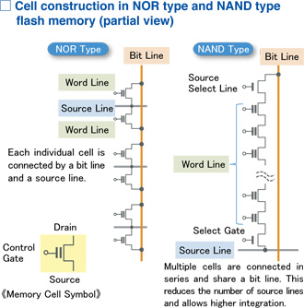
Flash memory chip
Notes:
There are two types of flash memory, namely the NOR type and NAND type, which employ the same basic cell structure but differ in the way these lines are connected. In a NOR type chip, the source line and bit line are connected individually to each cell, which makes it possible to perform write operations in 1-bit units.
By contrast, in a NAND type chip, multiple cells are connected in series between the source line and bit line. The width of each connecting line is only on the order of several tens of nanometers, but since the cells themselves are extremely small, the lines require a comparatively large amount of space in a NOR type chip where each cell has its own source line connection. A NAND type chip on the other hand allows higher integration because a source line is shared by multiple cells.

Slide 16
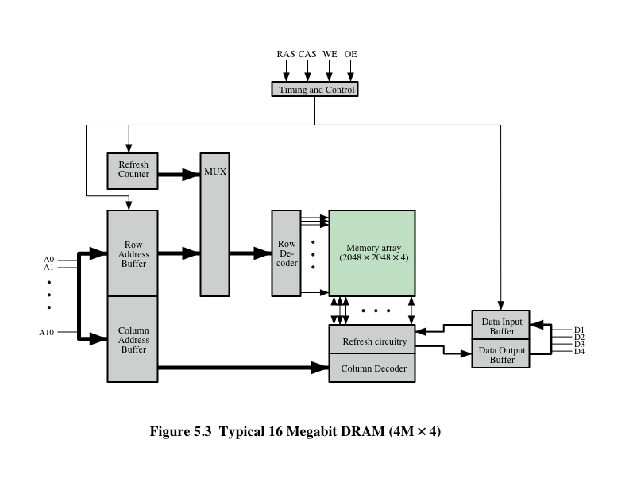
Typical 16 Mb DRAM (4M x 4)
Notes:
Figure 5.3 shows a typical organization of a 16-Mbit DRAM. In this case, 4 bits are read or written at a time. Logically, the memory array is organized as four square arrays of 2048 by 2048 elements. Various physical arrangements are possible. In any case, the elements of the array are connected by both horizontal (row) and vertical (column) lines. Each horizontal line connects to the Select terminal of each cell in its row; each vertical line connects to the Data-In/Sense terminal of each cell in its column.
Address lines supply the address of the word to be selected. A total of log₂ W lines are needed. In our example, 11 address lines are needed to select one of 2048 rows. These 11 lines are fed into a row decoder, which has 11 lines of input and 2048 lines for output. The logic of the decoder activates a single one of the 2048 outputs depending on the bit pattern on the 11 input lines (2¹¹ = 2048).
An additional 11 address lines select one of 2048 columns of 4 bits per column. Four data lines are used for the input and output of 4 bits to and from a data buffer. On input (write), the bit driver of each bit line is activated for a 1 or 0 according to the value of the corresponding data line. On output (read), the value of each bit line is passed through a sense amplifier and presented to the data lines. The row line selects which row of cells is used for reading or writing.
Because only 4 bits are read/written to this DRAM, there must be multiple DRAMs connected to the memory controller to read/write a word of data to the bus.
Note that there are only 11 address lines (A0–A10), half the number you would expect for a 2048 * 2048 array. This is done to save on the number of pins. The 22 required address lines are passed through select logic external to the chip and multiplexed onto the 11 address lines. First, 11 address signals are passed to the chip to define the row address of the array, and then the other 11 address signals are presented for the column address.
As an aside, multiplexed addressing plus the use of square arrays result in a quadrupling of memory size with each new generation of memory chips. One more pin devoted to addressing doubles the number of rows and columns, and so the size of the chip memory grows by a factor of 4.
Figure 5.3 also indicates the inclusion of refresh circuitry. All DRAMs require a refresh operation. A simple technique for refreshing is, in effect, to disable the DRAM chip while all data cells are refreshed. The refresh counter steps through all of the row values. For each row, the output lines from the refresh counter are supplied to the row decoder and the RAS line is activated. The data are read out and written back into the same location. This causes each cell in the row to be refreshed.

Slide 17
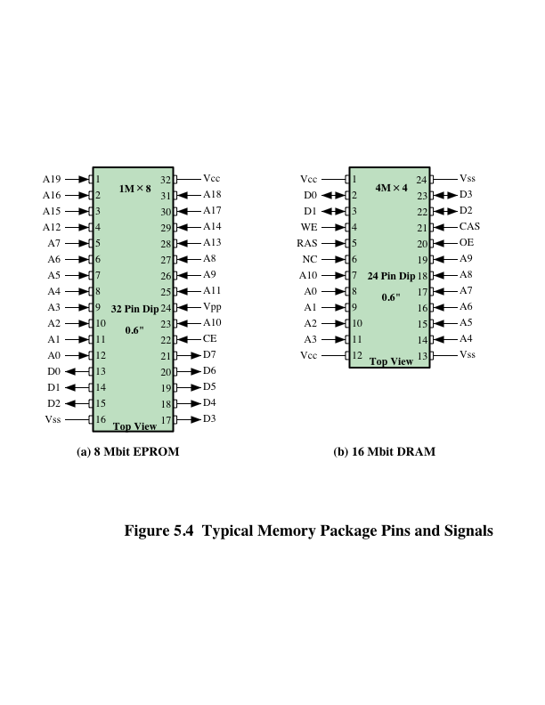
Chip Packaging
Notes:
As was mentioned in Chapter 2, an integrated circuit is mounted on a package that contains pins for connection to the outside world.
Figure 5.4a shows an example EPROM package, which is an 8-Mbit chip organized as 1M * 8. In this case, the organization is treated as a one-word-per-chip package. The package includes 32 pins, which is one of the standard chip package sizes. The pins support the following signal lines:
• The address of the word being accessed. For 1M words, a total of 20 (2²⁰ = 1M) pins are needed (A0–A19).
• The data to be read out, consisting of 8 lines (D0–D7).
• The power supply to the chip (V_{cc}).
• A ground pin (V_{ss}).
• A chip enable (CE) pin. Because there may be more than one memory chip, each of which is connected to the same address bus, the CE pin is used to indicate whether or not the address is valid for this chip. The CE pin is activated by logic connected to the higher-order bits of the address bus (i.e., address bits above A19). The use of this signal is illustrated presently.
• A program voltage (V_{pp}) that is supplied during programming (write operations).
A typical DRAM pin configuration is shown in Figure 5.4b, for a 16-Mbit chip organized as 4M * 4. There are several differences from a ROM chip. Because a RAM can be updated, the data pins are input/output. The write enable (WE) and output enable (OE) pins indicate whether this is a write or read operation.
Because the DRAM is accessed by row and column, and the address is multiplexed, only 11 address pins are needed to specify the 4M row/column combinations (2¹¹ * 2¹¹ = 2²² = 4M). The functions of the row address select (RAS) and column address select (CAS) pins were discussed previously. Finally, the no connect (NC) pin is provided so that there are an even number of pins.

Slide 18
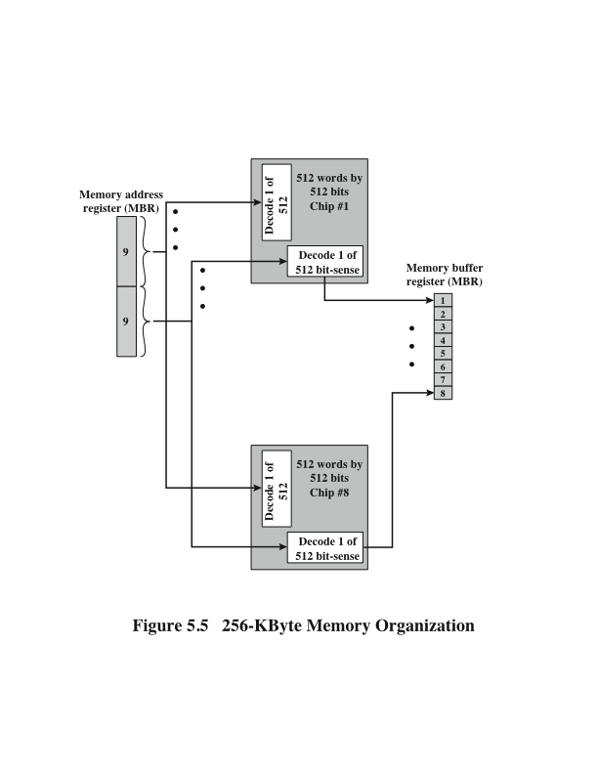
Diagram draw
Figure 5.5
256-KByte
Memory
Organization
Notes:
If a RAM chip contains only 1 bit per word, then clearly we will need at least a number of chips equal to the number of bits per word. As an example, Figure 5.5 shows how a memory module consisting of 256K 8-bit words could be organized. For 256K words, an 18-bit address is needed and is supplied to the module from some external source (e.g., the address lines of a bus to which the module is attached). The address is presented to 8 256K * 1-bit chips, each of which provides the input/output of 1 bit.

Slide 19
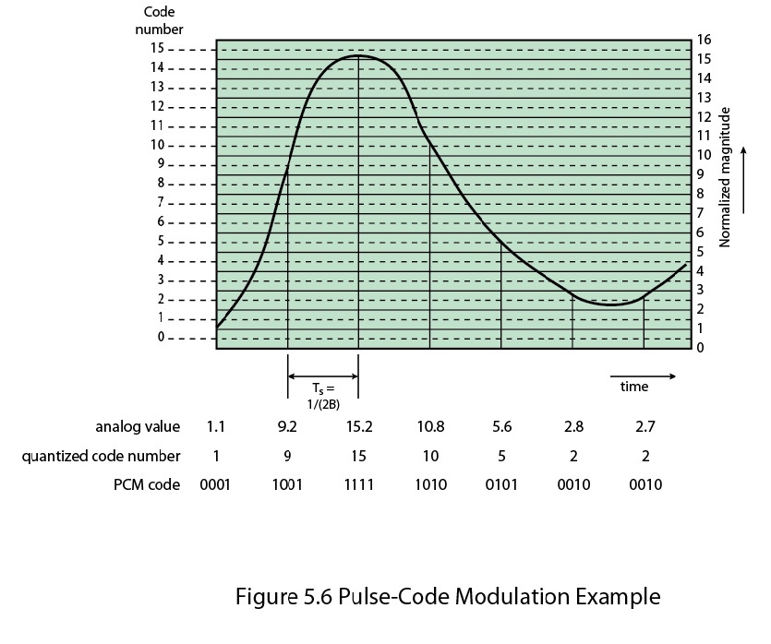
1MByte Module Organization(Not Discussed)
Notes:
This organization works as long as the size of memory equals the number of bits per chip. In the case in which larger memory is required, an array of chips is needed. Figure 5.6 shows the possible organization of a memory consisting of 1M word by 8 bits per word. In this case, we have four columns of chips, each column containing 256K words arranged as in Figure 5.5. For 1M word, 20 address lines are needed. The 18 least significant bits are routed to all 32 modules. The high-order 2 bits are input to a group select logic module that sends a chip enable signal to one of the four columns of modules.

Slide 20
Interleaved Memory
Composed of a collection of DRAM chips
Grouped together to form a memory bank
Each bank is independently able to service a memory read or write request
K banks can service K requests simultaneously, increasing memory read or write rates by a factor of K
If consecutive words of memory are stored in different banks, the transfer of a block of memory is speeded up
Notes:
Main memory is composed of a collection of DRAM memory chips. A number of chips can be grouped together to form a memory bank. It is possible to organize the memory banks in a way known as interleaved memory. Each bank is independently able to service a memory read or write request, so that a system with K banks can service K requests simultaneously, increasing memory read or write rates by a factor of K. If consecutive words of memory are stored in different banks, then the transfer of a block of memory is speeded up. Appendix E explores the topic of interleaved memory.

Slide 21
Error Correction
Hard Failure
Permanent physical defect
Memory cell or cells affected cannot reliably store data but become stuck at 0 or 1 or switch erratically between 0 and 1
Can be caused by:
Harsh environmental abuse
Manufacturing defects
Wear
Soft Error
Random, non-destructive event that alters the contents of one or more memory cells
No permanent damage to memory
Can be caused by:
Power supply problems
Alpha particles
Notes:
A semiconductor memory system is subject to errors. These can be categorized as hard failures and soft errors. A hard failure is a permanent physical defect so that the memory cell or cells affected cannot reliably store data but become stuck at 0 or 1 or switch erratically between 0 and 1. Hard errors can be caused by harsh environmental abuse, manufacturing defects, and wear. A soft error is a random, nondestructive event that alters the contents of one or more memory cells without damaging the memory. Soft errors can be caused by power supply problems or alpha particles. These particles result from radioactive decay and are distressingly common because radioactive nuclei are found in small quantities in nearly all materials. Both hard and soft errors are clearly undesirable, and most modern main memory systems include logic for both detecting and correcting errors.

Slide 22
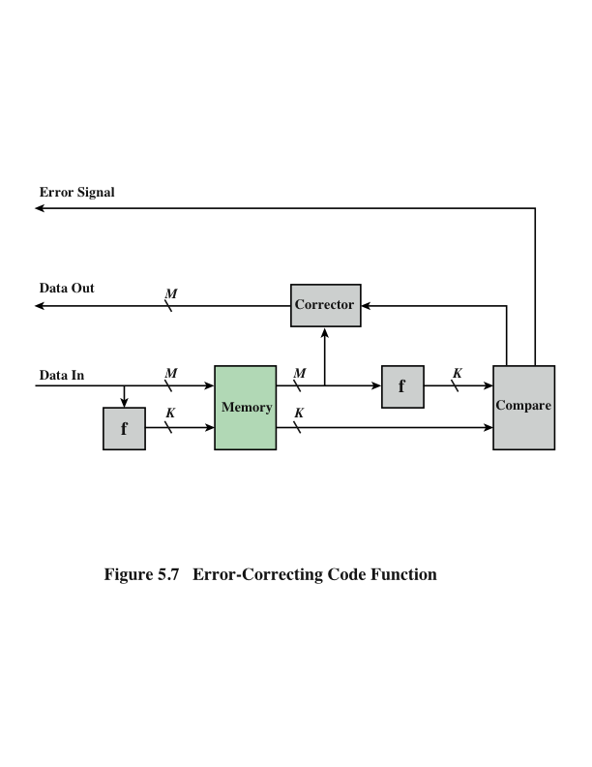
Error Correcting Code Function
Note Copy
Notes:
Figure 5.7 illustrates in general terms how the process is carried out. When data are to be written into memory, a calculation, depicted as a function f, is performed on the data to produce a code. Both the code and the data are stored. Thus, if an M-bit word of data is to be stored and the code is of length K bits, then the actual size of the stored word is M + K bits.
When the previously stored word is read out, the code is used to detect and possibly correct errors. A new set of K code bits is generated from the M data bits and compared with the fetched code bits. The comparison yields one of three results:
• No errors are detected. The fetched data bits are sent out.
• An error is detected, and it is possible to correct the error. The data bits plus error correction bits are fed into a corrector, which produces a corrected set of M bits to be sent out.
• An error is detected, but it is not possible to correct it. This condition is reported.
Codes that operate in this fashion are referred to as error-correcting codes. A code is characterized by the number of bit errors in a word that it can correct and detect.

Slide 23
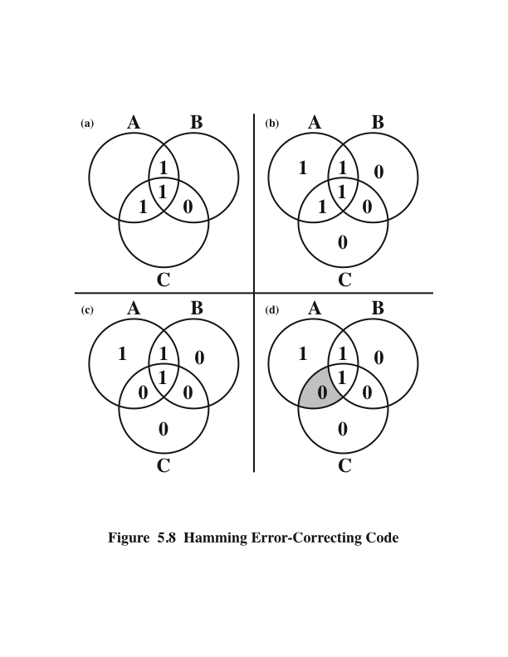
Hamming Error Correcting Code
NOTE COPY
Notes:
The simplest of the error-correcting codes is the Hamming code devised by Richard Hamming at Bell Laboratories. Figure 5.8 uses Venn diagrams to illustrate the use of this code on 4-bit words (M = 4). With three intersecting circles, there are seven compartments. We assign the 4 data bits to the inner compartments (Figure5.8a). The remaining compartments are filled with what are called parity bits. Each parity bit is chosen so that the total number of 1s in its circle is even (Figure5.8b). Thus, because circle A includes three data 1s, the parity bit in that circle is set to 1. Now, if an error changes one of the data bits (Figure 5.8c), it is easily found. By checking the parity bits, discrepancies are found in circle A and circle C but not in circle B. Only one of the seven compartments is in A and C but not B. The error can therefore be corrected by changing that bit.

Slide 24
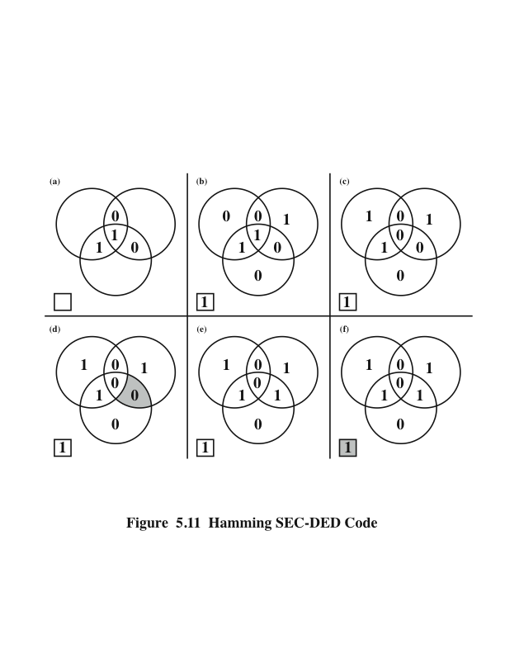
Hamming SEC-DED Code
Notes:
The code just described is known as a single-error-correcting (SEC) code. More commonly, semiconductor memory is equipped with a single-error-correcting, double-error-detecting (SEC-DED) code. As Table 5.2 shows, such codes require one additional bit compared with SEC codes.
Figure 5.11 illustrates how such a code works, again with a 4-bit data word. The sequence shows that if two errors occur (Figure 5.11c), the checking procedure goes astray (d) and worsens the problem by creating a third error (e). To overcome the problem, an eighth bit is added that is set so that the total number of 1s in the diagram is even. The extra parity bit catches the error (f).
An error-correcting code enhances the reliability of the memory at the cost of added complexity. With a 1-bit-per-chip organization, an SEC-DED code is generally considered adequate. For example, the IBM 30xx implementations used an 8-bit SECDED code for each 64 bits of data in main memory. Thus, the size of main memory is actually about 12% larger than is apparent to the user. The VAX computers used a 7-bit SEC-DED for each 32 bits of memory, for a 22% overhead. A number of contemporary DRAMs use 9 check bits for each 128 bits of data, for a 7% overhead [SHAR97].

Slide 25
Hamming Code Syndrome
If we compare the read K bits with the write K bits,
using an exclusive or function, the result is called
the “syndrome”.
- If the syndrome is all zeros, there were no errors,
i.e. the bits were exactly alike
- If there is a 1 bit somewhere, we know that 1
represents an error.
Notes:
4-bit syndrome for an 8-bit data word with the following characteristics:
• If the syndrome contains all 0s, no error has been detected.
• If the syndrome contains one and only one bit set to 1, then an error has occurred in one of the 4 check bits. No correction is needed.
• If the syndrome contains more than one bit set to 1, then the numerical value of the syndrome indicates the position of the data bit in error. This data bit is inverted for correction.

Slide 26
Hamming Code Design – determining K
To store an M bit word with detection/correction takes M+K bit words
If K =1, we can detect single bit errors but not correct them
If 2^{K} - 1 >= M + K , we can detect, identify, and correct all single bit errors, i.e. the syndrome contains the information to correct any single bit error
Example: For M = 8:
and K = 3: 2³ – 1 = 7 < 8 + 3 (doesn’t work)
and K = 4: 2⁴ – 1 = 15 > 8 + 4 (works!)
Therefore, we must choose K =4,
i.e., the minimum size of the syndrome is 4

Slide 27
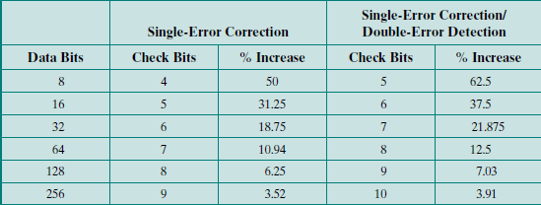
Table 5.2
Lists the number of check bits required for various data word lengths
Table 5.2 Lists the number of check bits required for various data word lengths

Slide 28
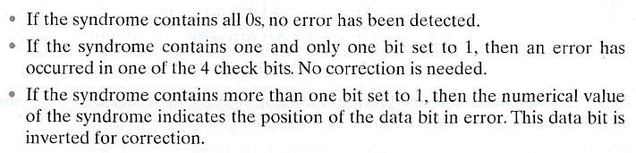
Hamming Code Syndrome Design Criteria

Slide 29
A Layout of Data and Check Bits that Achieves Our Design Criteria:
C1 is a parity check on every data bit whose position is xxx1
C1 = D1 exor D2 exor D4 exor D5 exor D7
C2 is a parity check on every data bit whose position is xx1x
C2 = D1 exor D3 exor D4 exor D6 exor D7
C4 is a parity check on every data bit whose position is x1xx
C4 = D2 exor D3 exor D4 exor D8
C8 is a parity check on every data bit whose position is 1xxx
C8 = D5 exor D6 exor D7 exor D8
Why this ordering? Because we want the syndrome, the Hamming test word, to yield the address of the error.

Slide 30
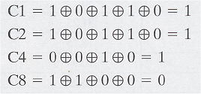
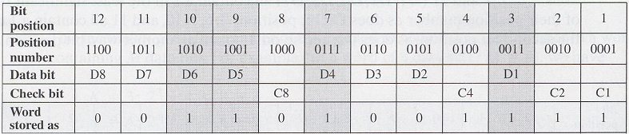
Example:
Data stored = 00111001
Check bits:
For odd no of 1 xor is 1
Else xor 0
Putting it together:

Slide 31
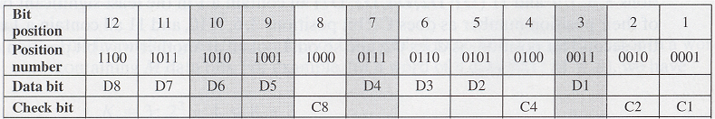
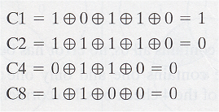
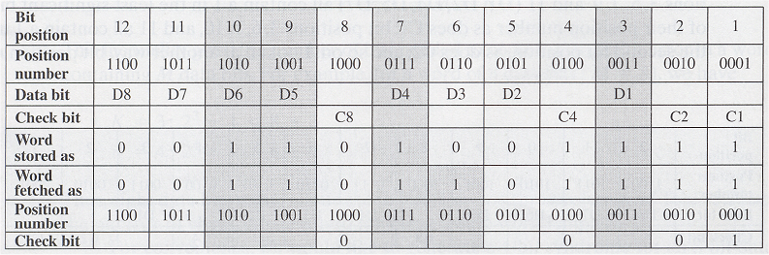
Example:
Word fetched:
Check Bits:
Comparing:
C8 C4 C2 C1
0 1 1 1 Orig Check Bits
0 0 0 1 New Check Bits
0 1 1 0 Syndrome
0110 = 6 ➔ bit position 6 is wrong, i.e. bit D3 is wrong
Putting it all together:
Notes:
Figure 5.10 illustrates the calculation. The data and check bits are positioned properly in the 12-bit word. Four of the data bits have a value 1 (shaded
in the table), and their bit position values are XORed to produce the Hamming code 0111, which forms the four check digits. The entire block that is stored is 001101001111. Suppose now that data bit 3, in bit position 6, sustains an error and is changed from 0 to 1. The resulting block is 1101101111, with a Hamming code of 0111. An XOR of the Hamming code and all of the bit position values for nonzero data bits results in 0110. The nonzero result detects an error and indicates that the error is in bit position 6.

Slide 32
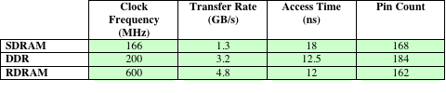
Advanced DRAM Organization
SDRAM
One of the most critical system bottlenecks when using high-performance processors is the interface to main internal memory
The traditional DRAM chip is constrained both by its internal architecture and by its interface to the processor’s memory bus
A number of enhancements to the basic DRAM architecture have been explored:
DDR-DRAM
RDRAM
Table 5.3 Performance Comparison of Some DRAM Alternatives
Notes:
As discussed in Chapter 2, one of the most critical system bottlenecks when using high-performance processors is the interface to main internal memory. This interface is the most important pathway in the entire computer system. The basic building block of main memory remains the DRAM chip, as it has for decades; until recently, there had been no significant changes in DRAM architecture since the early 1970s. The traditional DRAM chip is constrained both by its internal architecture and by its interface to the processor’s memory bus.
We have seen that one attack on the performance problem of DRAM main memory has been to insert one or more levels of high-speed SRAM cache between the DRAM main memory and the processor. But SRAM is much costlier than DRAM, and expanding cache size beyond a certain point yields diminishing returns.
In recent years, a number of enhancements to the basic DRAM architecture have been explored, and some of these are now on the market. The schemes that currently dominate the market are SDRAM, DDR-DRAM, and RDRAM. Table 5.3 provides a performance comparison. CDRAM has also received considerable attention. We examine each of these approaches in this section.

Slide 33
Synchronous DRAM (SDRAM)
One of the most widely used forms of DRAM
Exchanges data with the processor synchronized to an external clock signal and running at the full speed of the processor/memory bus without imposing wait states
With synchronous access the DRAM moves data in and out under control of the system clock
The processor or other master issues the instruction and address information which is latched by the DRAM
The DRAM then responds after a set number of clock cycles
Meanwhile the master can safely do other tasks while the SDRAM is processing
Notes:
One of the most widely used forms of DRAM is the synchronous DRAM (SDRAM) [VOGL94]. Unlike the traditional DRAM, which is asynchronous, the
SDRAM exchanges data with the processor synchronized to an external clock signal and running at the full speed of the processor/memory bus without imposing wait states.
In a typical DRAM, the processor presents addresses and control levels to the memory, indicating that a set of data at a particular location in memory should be either read from or written into the DRAM. After a delay, the access time, the DRAM either writes or reads the data. During the access-time delay, the DRAM performs various internal functions, such as activating the high capacitance of the row and column lines, sensing the data, and routing the data out through the output buffers. The processor must simply wait through this delay, slowing system performance.
With synchronous access, the DRAM moves data in and out under control of the system clock. The processor or other master issues the instruction and address information, which is latched by the DRAM. The DRAM then responds after a set number of clock cycles. Meanwhile, the master can safely do other tasks while the SDRAM is processing the request.

Slide 34
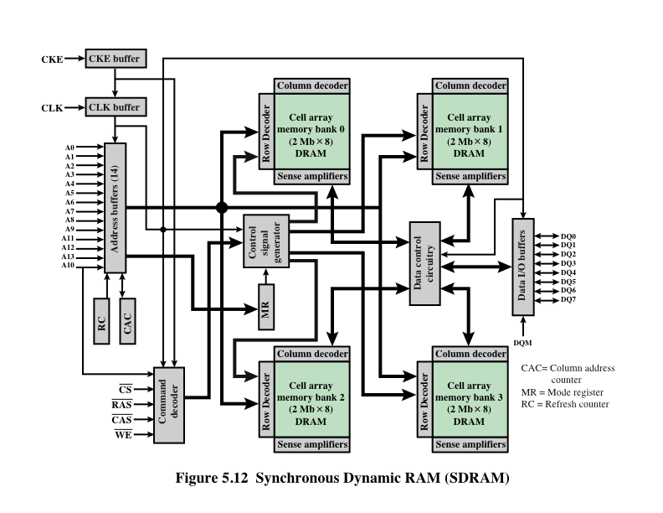
SDRAM
Notes:
Figure 5.12 shows the internal logic of IBM’s 64-Mb SDRAM [IBM01], which is typical of SDRAM organization.
Decoders needed for checking parity bits

Slide 35
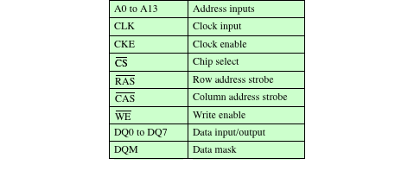
SDRAM Pin Assignments(ND)
Table 5.4 SDRAM Pin Assignments
Notes:
Table 5.4 defines the various pin assignments. The SDRAM employs a burst mode to eliminate the address setup time and row and column line pre-charge time after the first access. In burst mode, a series of data bits can be clocked out rapidly after the first bit has been accessed. This mode
is useful when all the bits to be accessed are in sequence and in the same row of the array as the initial access. In addition, the SDRAM has a multiple-bank internal architecture that improves opportunities for on-chip parallelism.
The mode register and associated control logic is another key feature differentiating SDRAMs from conventional DRAMs. It provides a mechanism to
customize the SDRAM to suit specific system needs. The mode register specifies the burst length, which is the number of separate units of data synchronously fed onto the bus. The register also allows the programmer to adjust the latency between receipt of a read request and the beginning of data transfer.
The SDRAM performs best when it is transferring large blocks of data serially, such as for applications like word processing, spreadsheets, and multimedia.

Slide 36
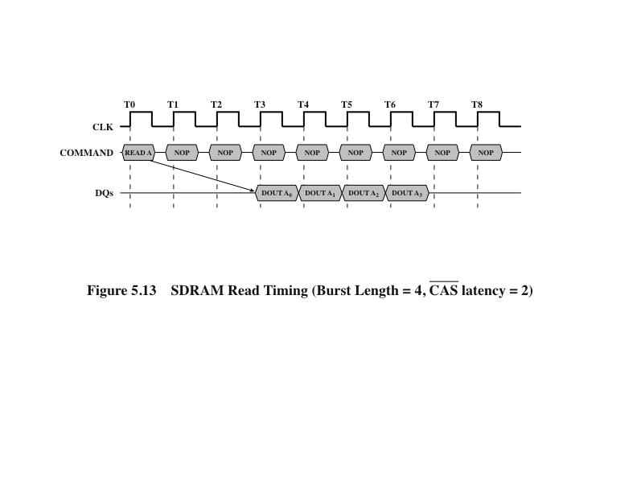
SDRAM Read Timing
Note Copy
Notes:
Figure 5.13 shows an example of SDRAM operation.

Slide 37
Double Data Rate SDRAM (DDR SDRAM)
SDRAM can only send data once per bus clock cycle
Double-data-rate SDRAM can send data twice per clock cycle, once on the rising edge of the clock pulse and once on the falling edge
Developed by the JEDEC Solid State Technology Association (Electronic Industries Alliance’s semiconductor-engineering-standardization body)
Notes:
SDRAM is limited by the fact that it can only send data to the processor once per bus clock cycle. A new version of SDRAM, referred to as double-data-rate SDRAM can send data twice per clock cycle, once on the rising edge of the clock pulse and once on the falling edge.
xxxxxx
DDR DRAM was developed by the JEDEC Solid State Technology Association, the Electronic Industries Alliance’s semiconductor-engineering-standardization body. Numerous companies make DDR chips, which are widely used in desktop computers and servers.

Slide 38
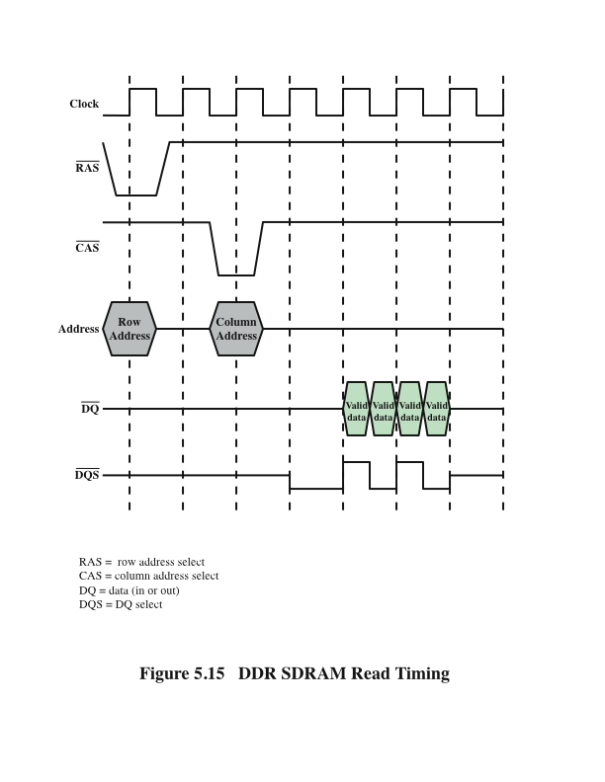
DDR SDRAM Read Timing
Notes:
Figure 5.15 shows the basic timing for a DDR read. The data transfer is synchronized to both the rising and falling edge of the clock. It is also synchronized to a bidirectional data strobe (DQS) signal that is provided by the memory controller during a read and by the DRAM during a write. In typical implementations the DQS is ignored during the read. An explanation of the use of DQS on writes is beyond our scope; see [JACO08] for details.
There have been two generations of improvement to the DDR technology. DDR2 increases the data transfer rate by increasing the operational frequency
of the RAM chip and by increasing the prefetch buffer from 2 bits to 4 bits per chip. The prefetch buffer is a memory cache located on the RAM chip. The buffer enables theRAM chip to preposition bits to be placed on the data bus as rapidly as possible. DDR3, introduced in 2007, increases the prefetch buffer size to 8 bits.
Theoretically, a DDR module can transfer data at a clock rate in the range of 200 to 600 MHz; a DDR2 module transfers at a clock rate of 400 to 1066 MHz; and a DDR3 module transfers at a clock rate of 800 to 1600 MHz. In practice, somewhat smaller rates are achieved.
Appendix K provides more detail on DDR technology.

Slide 39
DDR2 SDRAM (Double Data Rate Two SDRAM)
Its primary benefit is the ability to operate the external data bus twice as fast as DDR SDRAM. This is achieved by improved bus signal.
The prefetch buffer of DDR2 is 4 bit(double of DDR SDRAM). DDR2 memory is at the same internal clock speed (133~200MHz) as DDR, but the transfer rate of DDR2 can reach 533~800 MT/s with the improved I/O bus signal. DDR2 533 and DDR2 800 memory types are on the market.

Slide 40
DDR3 SDRAM (Double Data Rate Three SDRAM)
DDR3 memory reduces 40% power consumption compared to current DDR2 modules, allowing for lower operating currents and voltages (1.5 V, compared to DDR2's 1.8 V or DDR's 2.5 V).
The transfer rate of DDR3 is 800~1600 MT/s.
DDR3's prefetch buffer width is 8 bit, whereas DDR2's is 4 bit, and DDR's is 2 bit.
DDR3 also adds two functions, such as ASR (Automatic Self-Refresh) and SRT (Self-Refresh Temperature). They can make the memory control the refresh rate according to the temperature variation.

Slide 41
DDR4 SDRAM (Double Data Rate Fourth SDRAM)
DDR4 SDRAM provides the lower operating voltage (1.2V) and higher transfer rate. The transfer rate of DDR4 is 2133~3200 MT/s.
DDR4 adds four new Bank Groups technology. Each bank group has the feature of singlehanded operation.
DDR4 can process 4 data within a clock cycle, so DDR4's efficiency is better than DDR3 obviously.
DDR4 also adds some functions, such as DBI (Data Bus Inversion), CRC (Cyclic Redundancy Check) and CA(Command Address) parity. They can enhance DDR4 memory's signal integrity, and improve the stability of data transmission/access.

Slide 42
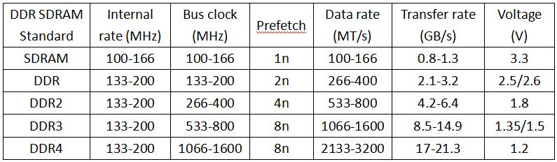
Comparison between SDRAM, DDR1, DDR2, DDR3 and DDR4
Note Copy

Slide 43
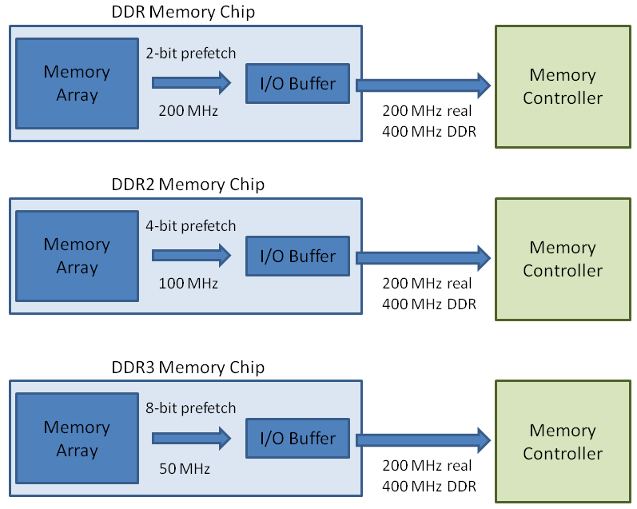
Comparison between SDRAM, DDR, DDR2 and DDR3(Ignored)

Slide 44
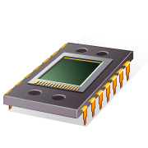
RDRAM
Developed by Rambus
Adopted by Intel for its Pentium and Itanium processors
Has become the main competitor to SDRAM
Chips are vertical packages with all pins on one side
Exchanges data with the processor over 28 wires no more than 12 centimeters long
Bus can address up to 320 RDRAM chips and is rated at 1.6 GBps
Bus delivers address and control information using an asynchronous block-oriented protocol
Gets a memory request over the high-speed bus
Request contains the desired address, the type of operation, and the number of bytes in the operation
Notes:
RDRAM, developed by Rambus [FARM92, CRIS97], has been adopted by Intel for its Pentium and Itanium processors. It has become the main competitor to SDRAM. (RDRAM chips are vertical packages, with all pins on one side. The chip exchanges data with the processor over 28 wires no more than 12 centimeters long. The bus can address up to 320 RDRAM chips and is rated at 1.6 GBps.)
The special RDRAM bus delivers address and control information using an asynchronous block-oriented protocol. After an initial 480 ns access time,
this produces the 1.6 GBps data rate. What makes this speed possible is the bus itself, which defines impedances, clocking, and signals very precisely. Rather than being controlled by the explicit RAS, CAS, R/W, and CE signals used in conventional DRAMs, an RDRAM gets a memory request over the high-speed bus. This request contains the desired address, the type of operation, and the number of bytes in the operation.

Slide 45
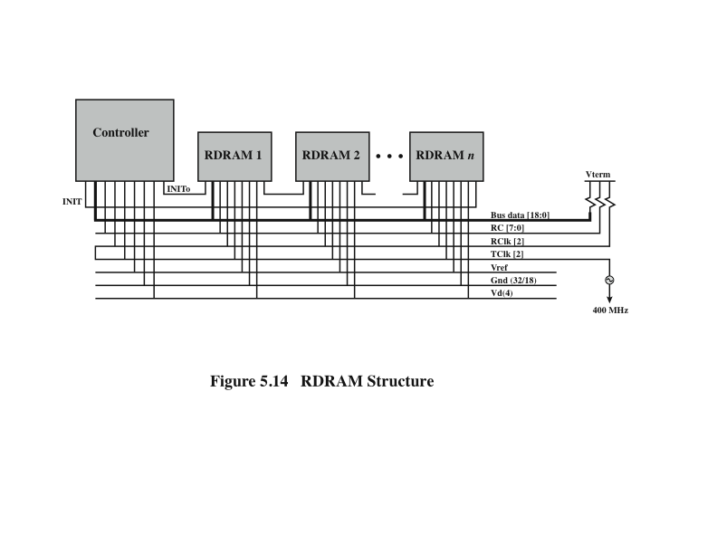
RDRAM Structure
Notes:
Figure 5.14 illustrates the RDRAM layout. The configuration consists of a controller and a number of RDRAM modules connected via a common bus.
The controller is at one end of the configuration, and the far end of the bus is a parallel termination of the bus lines. The bus includes 18 data lines (16 actual data, two parity) cycling at twice the clock rate; that is, 1 bit is sent at the leading and following edge of each clock signal. This results in a signal rate on each data line of 800 Mbps. There is a separate set of 8 lines (RC) used for address and control signals. There is also a clock signal that starts at the far end from the controller propagates to the controller end and then loops back. A RDRAM module sends data to the controller synchronously to the clock to master, and the controller sends data to an RDRAM synchronously with the clock signal in the opposite direction. The remaining bus lines include a reference voltage, ground, and power source.

Slide 46
RDRAM - Performance
(Compared to other contemporary standards, Rambus showed increase in latency, heat output, manufacturing complexity, and cost.) Because of more complex interface circuitry and increased number of memory banks, RDRAM die size was larger than that of contemporary SDRAM chips, and results in a 10–20 percent price premium at 16 Mbit densities

Slide 47
Cache DRAM (CDRAM)
Developed by Mitsubishi
Integrates a small SRAM cache onto a generic DRAM chip
SRAM on the CDRAM can be used in two ways:
It can be used as a true cache consisting of a number of 64-bit lines
Cache mode of the CDRAM is effective for ordinary random access to memory
Can also be used as a buffer to support the serial access of a block of data
Notes:
(Cache DRAM (CDRAM), developed by Mitsubishi [HIDA90, ZHAN01], integrates a small SRAM cache (16 Kb) onto a generic DRAM chip.)
(The SRAM on the CDRAM can be used in two ways. First, it can be used as a true cache), consisting of a number of 64-bit lines. The cache mode of the CDRAM is effective for ordinary random access to memory.
(The SRAM on the CDRAM can also be used as a buffer to support the serial access of a block of data). For example, to refresh a bit-mapped screen, the CDRAM can prefetch the data from the DRAM into the SRAM buffer. Subsequent accesses to the chip result in accesses solely to the SRAM.

Slide 48
Summary
Internal
Memory
Chapter 5
Semiconductor main memory
Organization
DRAM and SRAM
Types of ROM
Chip logic
Chip packaging
Module organization
Interleaved memory
Error correction
Hard failure
Soft error
Hamming code
Advanced DRAM organization
Synchronous DRAM
Rambus DRAM
DDR SDRAM
Cache DRAM
Notes:
Chapter 5 summary.

